Slide 1


Cybersecurity for EV Charging Station
GTU SBTP -2026 (Subject Code: DI05000011)
Student Name :Avadh Bhatti Dilipbhai
Enrollment no.:246190309009
College Name :Govt. polytechnic Junagadh
Branch and Year :Electrical branch & 2024 to 2027
Branch code:09
Gender :MALE
Registered Mail ID :a.d.bhatti.2409@gmail.com
Contact No.7405002828

Slide 2
What I learned in the Cybersecurity Program?
-Gained fundamental knowledge of cybersecurity and information security concepts.
-Learned about ethical hacking techniques and cyber attack methods.
-Understood different types of malware and their effects on computer systems.
-Developed basic skills in using Kali Linux and Linux commands.
-Learned cybersecurity risk identification and prevention techniques.
-Improved understanding of network security and common vulnerabilities.
-Gained practical exposure through master classes, demonstrations, and online learning activities.
-Enhanced analytical thinking and problem-solving skills related to cybersecurity.
-Learned the importance of secure practices and cyber awareness.

Slide 3
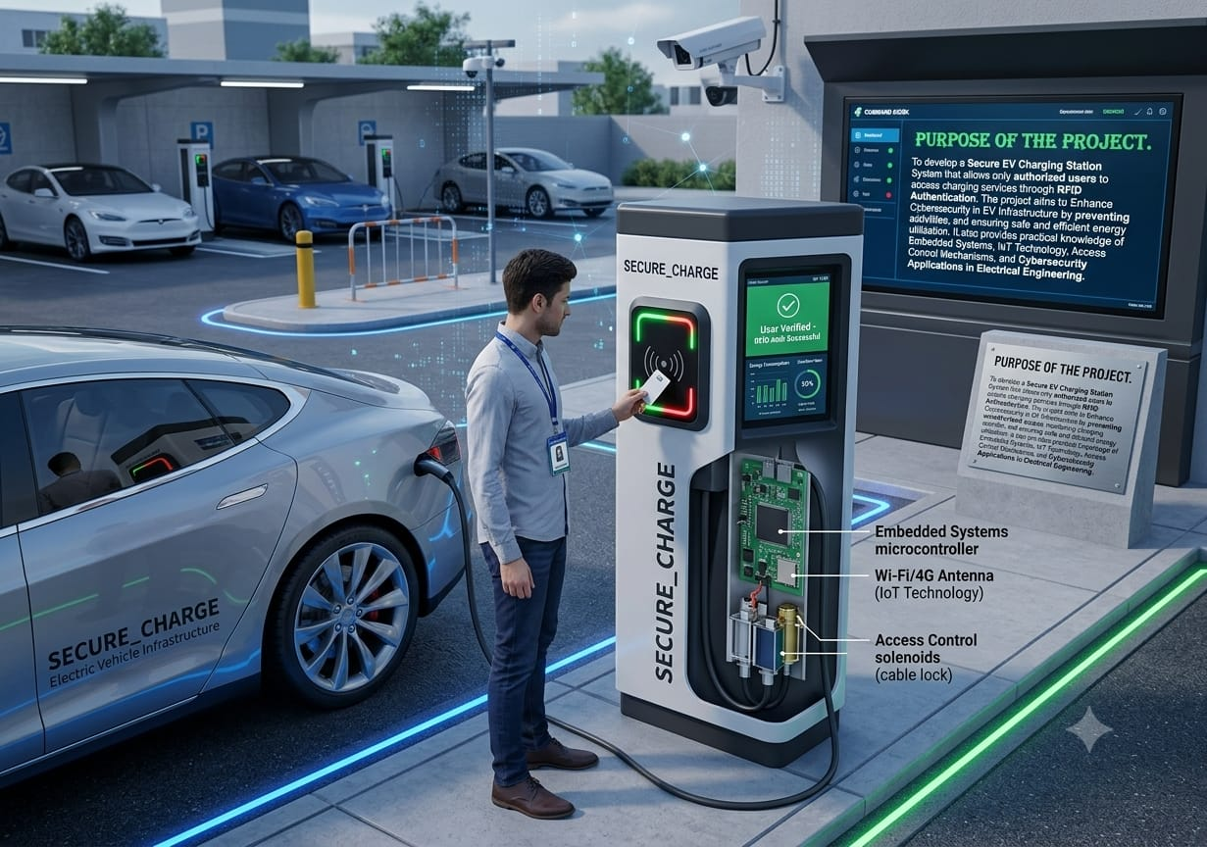
Purpose of the Project.
To develop a Secure EV Charging Station System that allows only authorized users to access charging services through RFID Authentication. The project aims to Enhance Cybersecurity in EV Infrastructure by preventing unauthorized access, monitoring charging activities, and ensuring safe and efficient energy utilization. It also provides practical knowledge of Embedded Systems, IoT Technology, Access Control Mechanisms, and Cybersecurity Applications in Electrical Engineering.

Slide 4
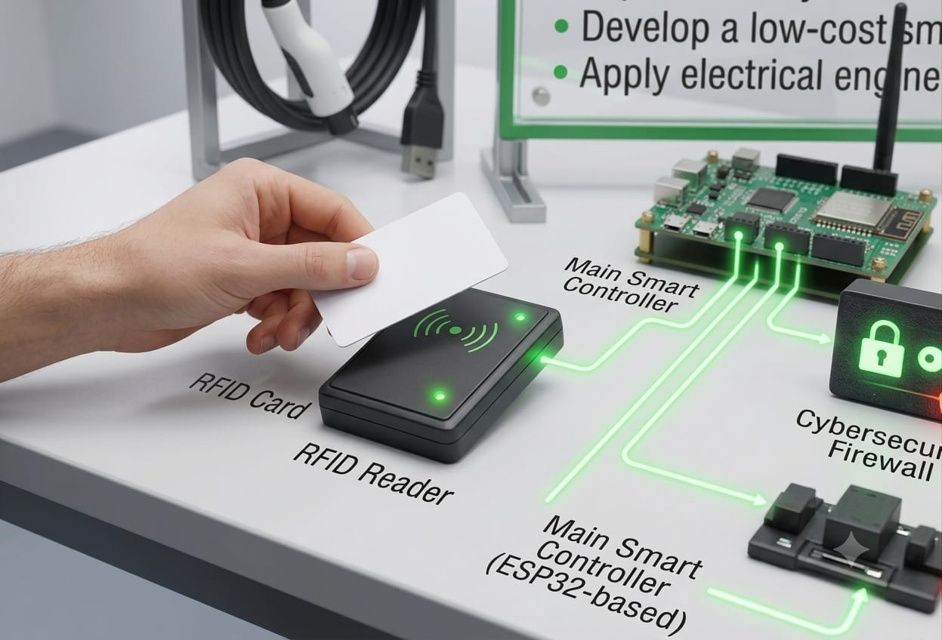
Project Objectives
- Implement RFID-based authentication.
- Prevent unauthorized access to charging stations.
- Enhance cybersecurity in EV infrastructure.
- Monitor charging activities.
- Measure energy consumption.
- Provide overcurrent protection.
- Integrate IoT-based monitoring.
- Improve safety and reliability.
- Develop a low-cost smart solution.
- Apply electrical engineering and cybersecurity concepts.

Slide 5
Need of the project.
- Cybersecurity threats in smart charging systems are increasing.
- There is a need for a safe, reliable, and cost-effective charging solution.
- Increasing adoption of electric vehicles requires secure charging infrastructure.
- Unauthorized access can lead to energy theft and misuse of charging stations.

Slide 6
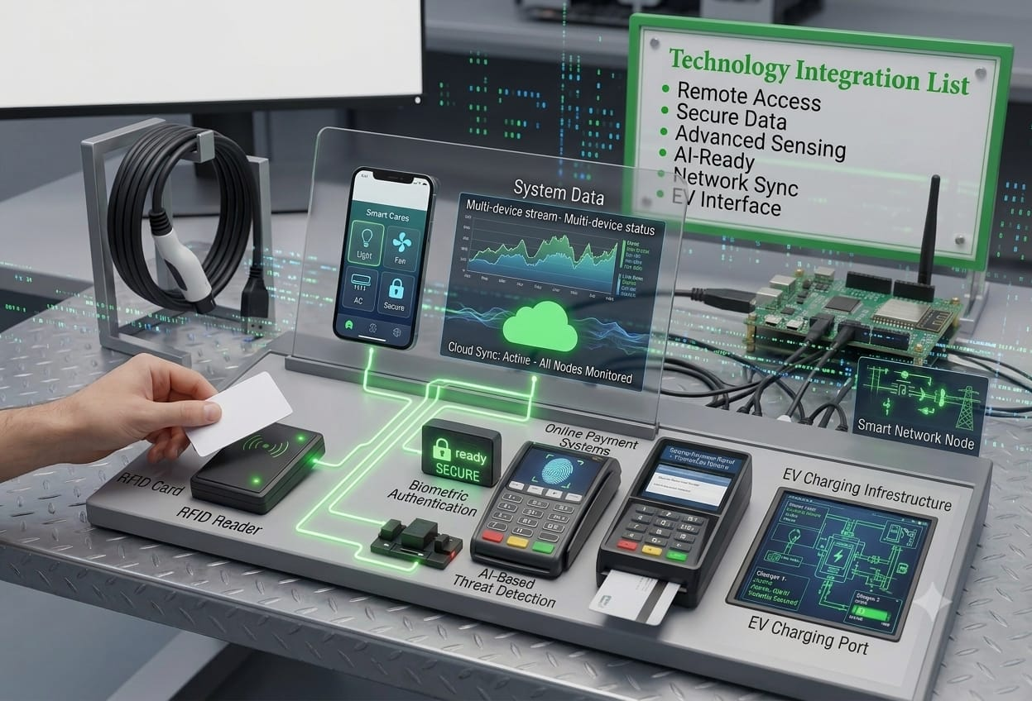
Enhancement Possibilities.
- Mobile Application Control
- Cloud-Based Monitoring
- Online Payment Systems
- Biometric Authentication
- AI-Based Threat Detection
- Smart Grid Integration
- EV Charging Infrastructure

Slide 7
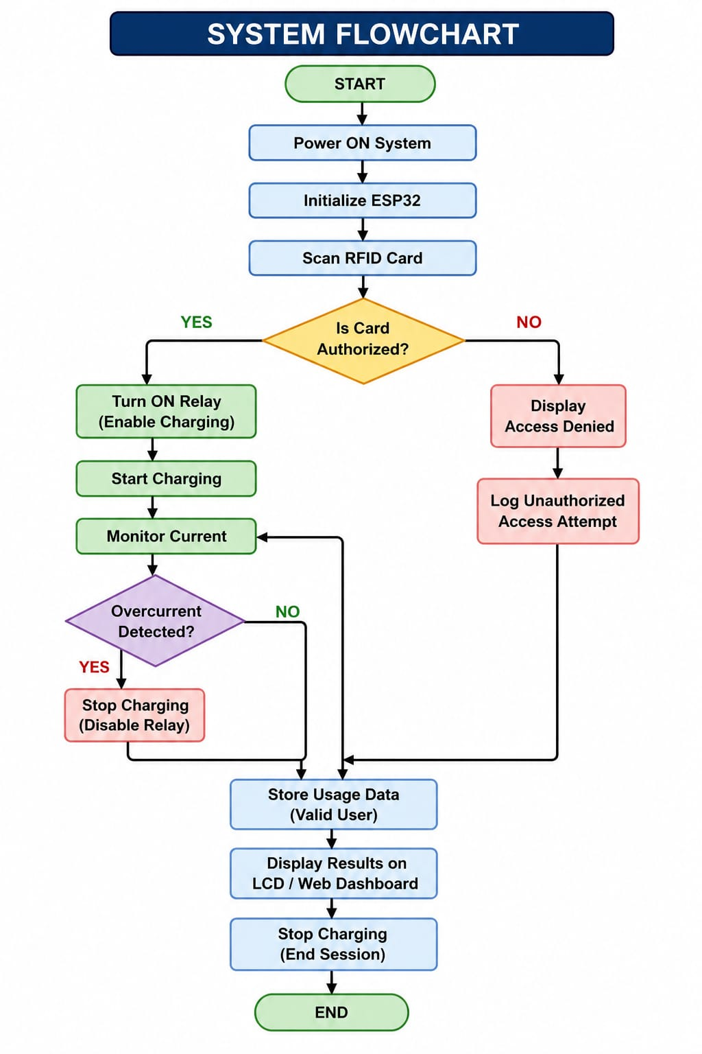
Working Methodology.
-The system authenticates users through RFID, enables secure EV charging, monitors operation, and records charging data.

Slide 8
Advantages and Limitations of Project.
Sr. no | ADVANTAGES | LIMITATIONS
1. | Provides secure access through RFID authentication. | RFID cards can be lost or damaged.
2. | Prevents unauthorized use of charging stations. | Requires a stable power supply and proper hardware setup.
3. | Easy to operate and user-friendly. | Basic RFID systems may have limited security compared to biometric systems.
4. | Improves cybersecurity in EV charging infrastructure. | Internet connection is required for advanced IoT features.

Slide 9
Challenges faced in this project.
- RFID and ESP32 integration.
- Hardware wiring and troubleshooting.
- Code debugging and testing.
- Implementing secure authentication.
- Simulation and performance testing.
- Ensuring reliable system operation.

Slide 10
Git Hub Link for Project.
https://github.com/avadhbhatti/Avadh-.git

Slide 11
Conclusion
- Developed a secure RFID-based EV charging system.
- Prevented unauthorized access through authentication.
- Improved security and monitoring of charging activities.
- Integrated Electrical Engineering, loT, and Cybersecurity concepts.
- Provided a reliable and scalable solution for smart EV charging infrastructure.

Slide 12
